Slide 1


QuickLearning App
CAPSTONE PROJECT
GUIDED BY:- Prof. Henry Wong

Slide 2

Agenda
Feedback
Accountabilities
Problem statement
Project Description
Personas
MVP
Technologies
Diagrams
Sprint 5 Recap
Product Backlog
Sprint Backlog
User stories
Test cases
Metrics
Retrospective
Stories committed for Sprint 5
App Demo

Slide 3

Accountabilities

Slide 4
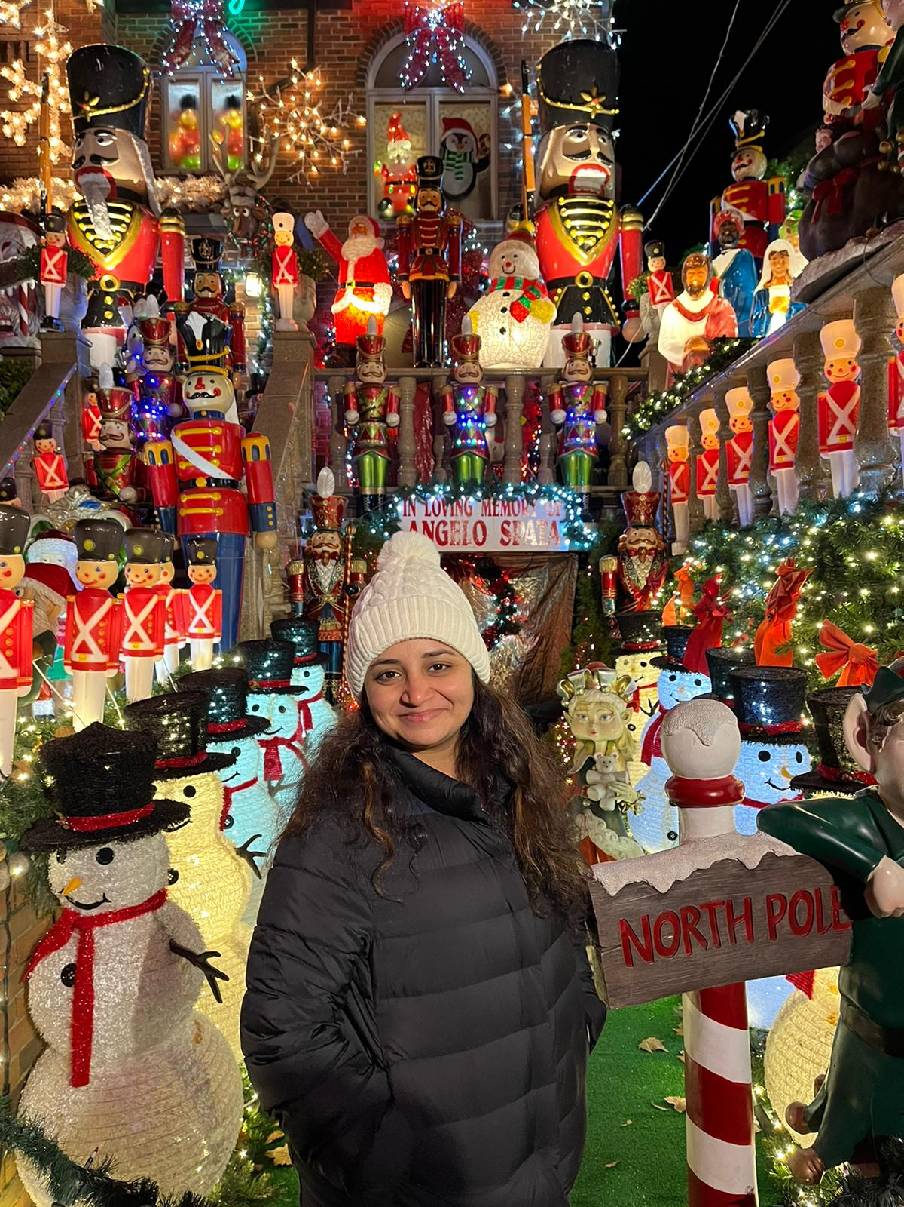


SHARANYA DAVE
Database Administrator
SRAVANI EATA
Software Tester
USHA SRI TIRUMALASETTY
Team Manager

Slide 5


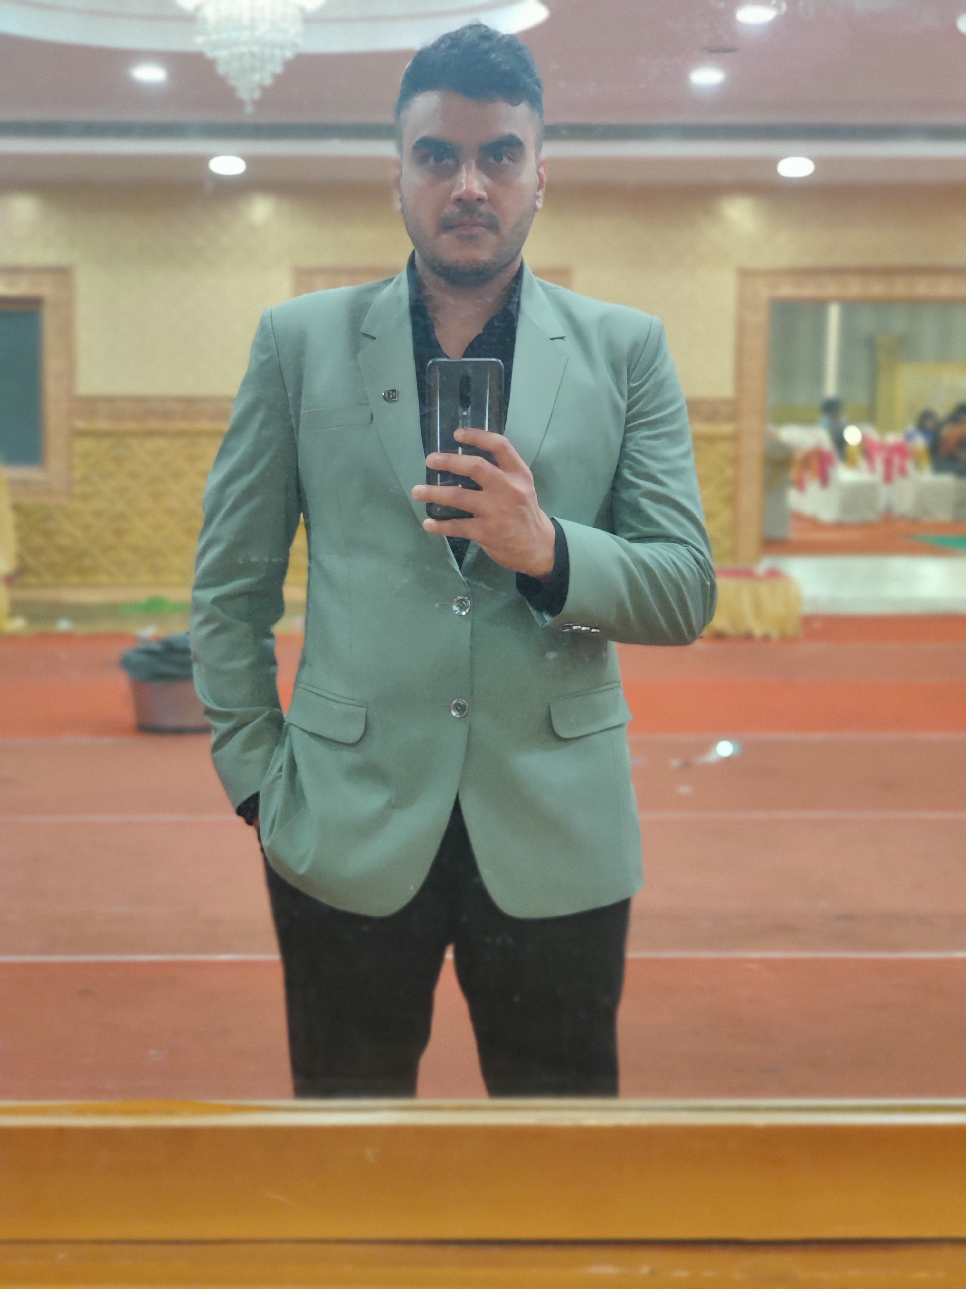
AMIT BHAYAL
Software Developer
ANKUSH RAJESH GURHANI
Software Developer
GENIUS MACHADO
Quality Analyst

Slide 6

Improvements Made
Change in Retrospective: Retrospect meaning past events we have divided that into two sections the event, and the action items to improve the same

Slide 7

Project Description
Quick Learning is a software that is designed specifically to create, distribute, and manage the delivery of educational content.
The Quick Learning application can be hosted as a stand-alone product on the company server, or it can be a cloud-based platform that is hosted by the software firm.
The goal of this project is knowledge management which means gathering, organizing, sharing and analysis of knowledge/resources about a topic in depth.

Slide 8
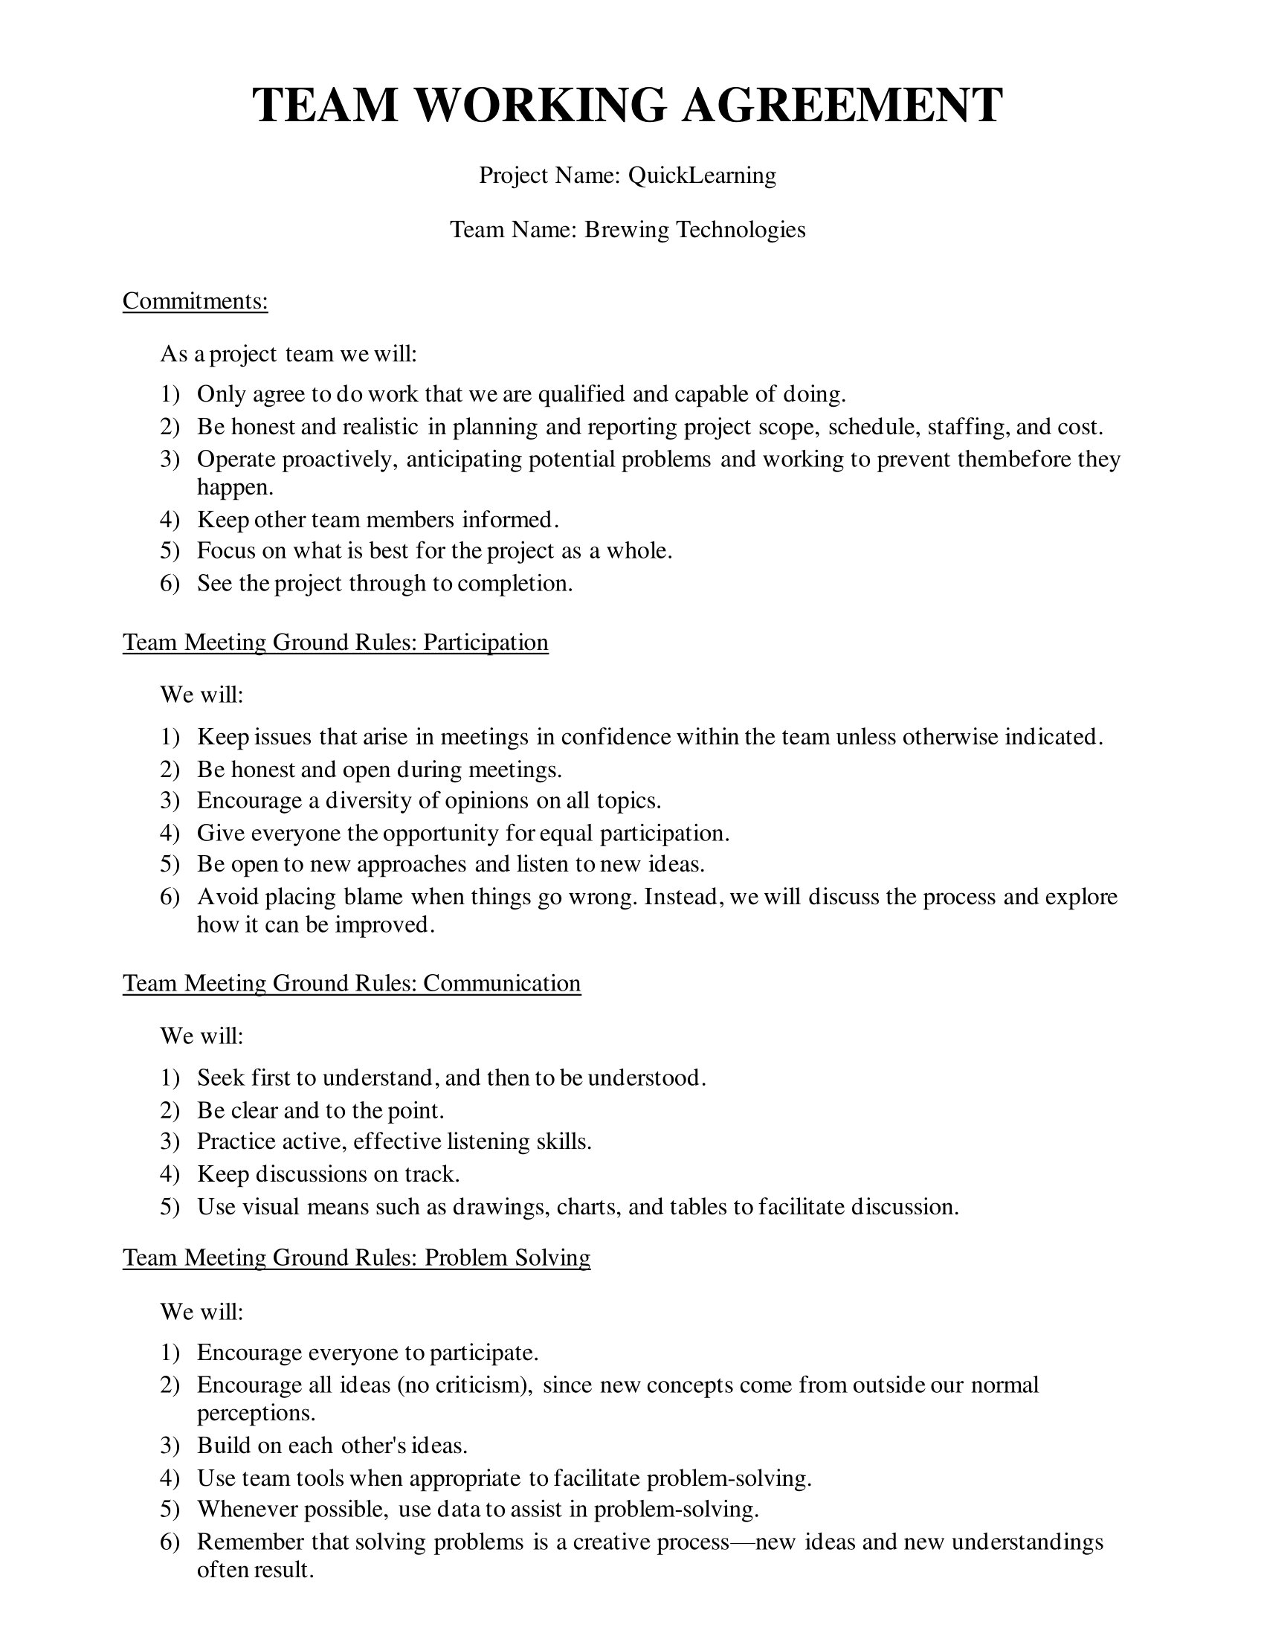
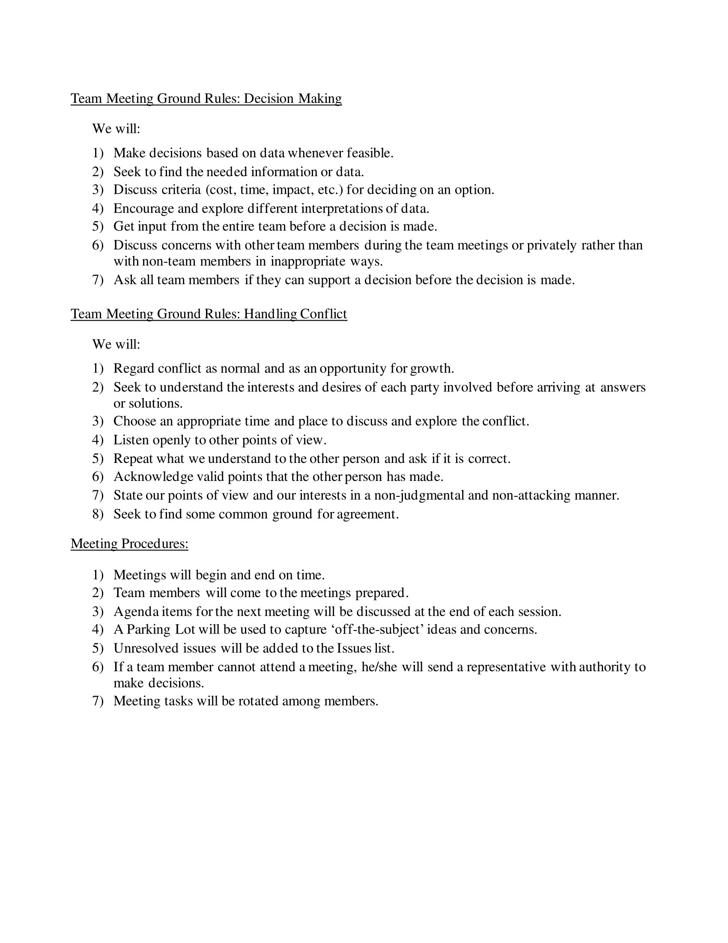

Slide 9

Personas

Slide 10
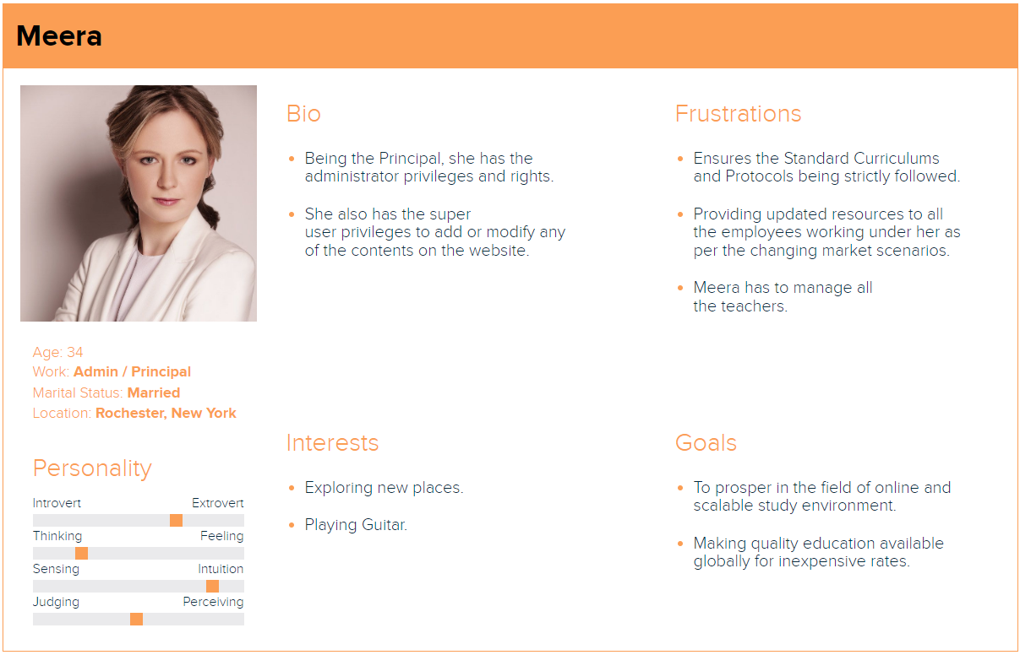

Slide 11
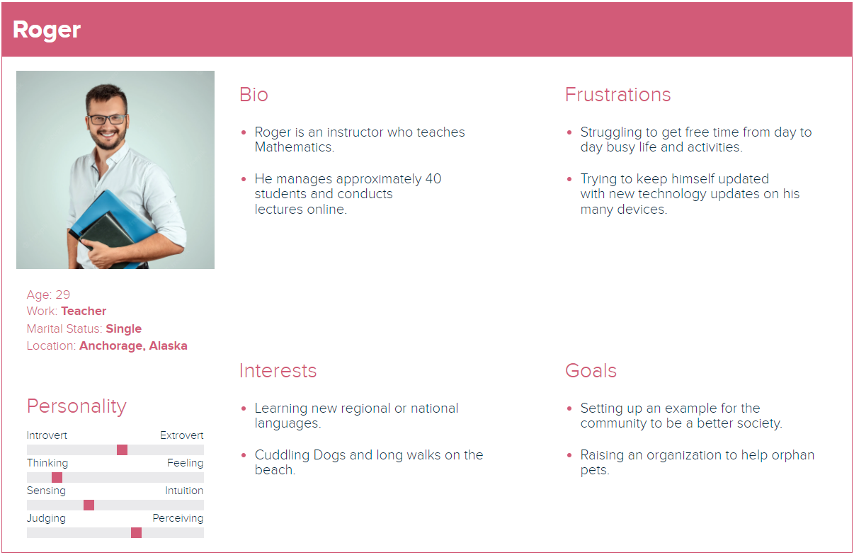

Slide 12
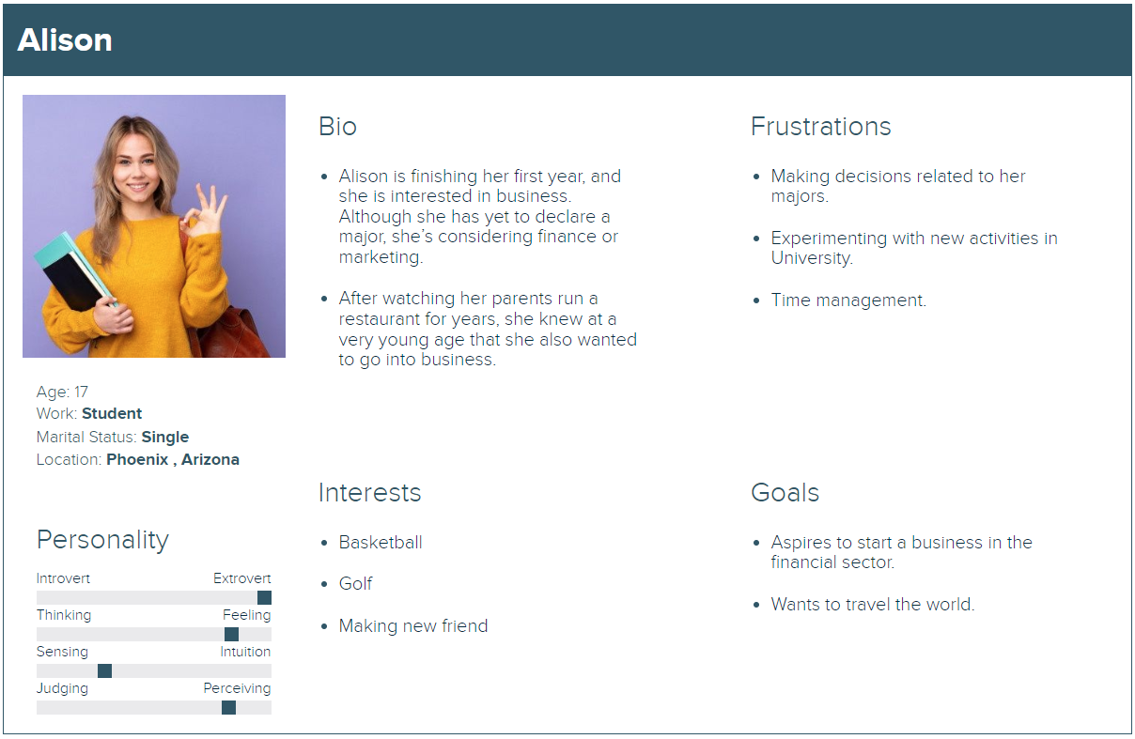

Slide 13
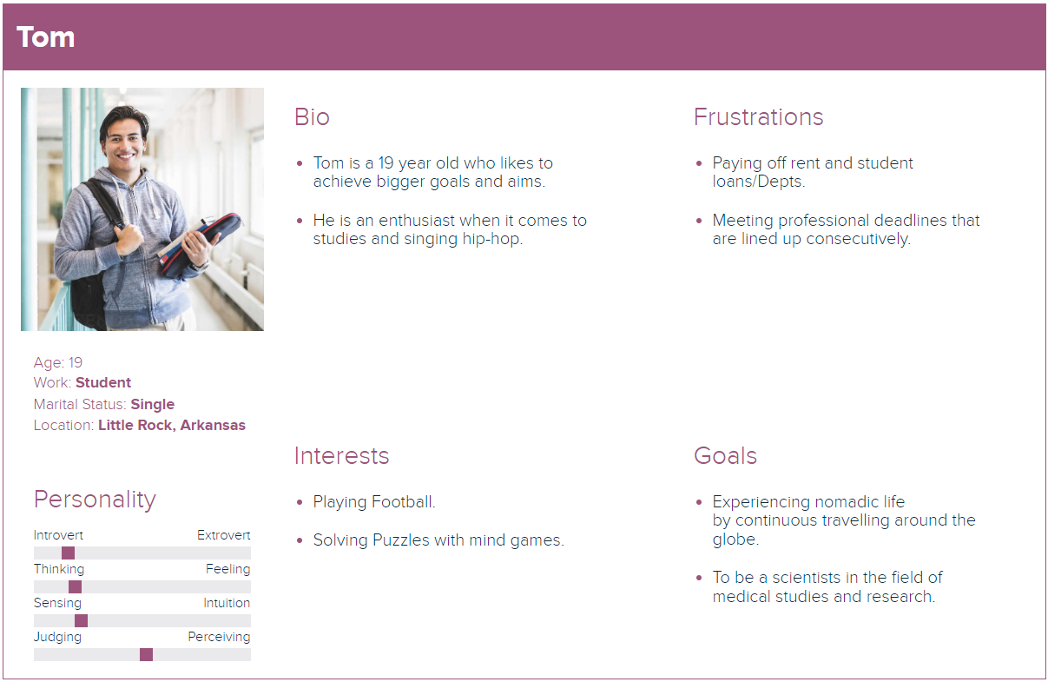

Slide 14

Minimal Viable Product(MVP)
Login
Registration/Signup
Homepage
Instructor Page
User can register into application.
User can login into the application with valid credentials.
User can view the course.
Instructor can add course through this page.
Logout
Admin Dashboard
Course
User can Logout from the application.
Minimal settings page for admin & enrolment of a student.
Add and delete course for the Admin.

Slide 15
Technologies

Slide 16
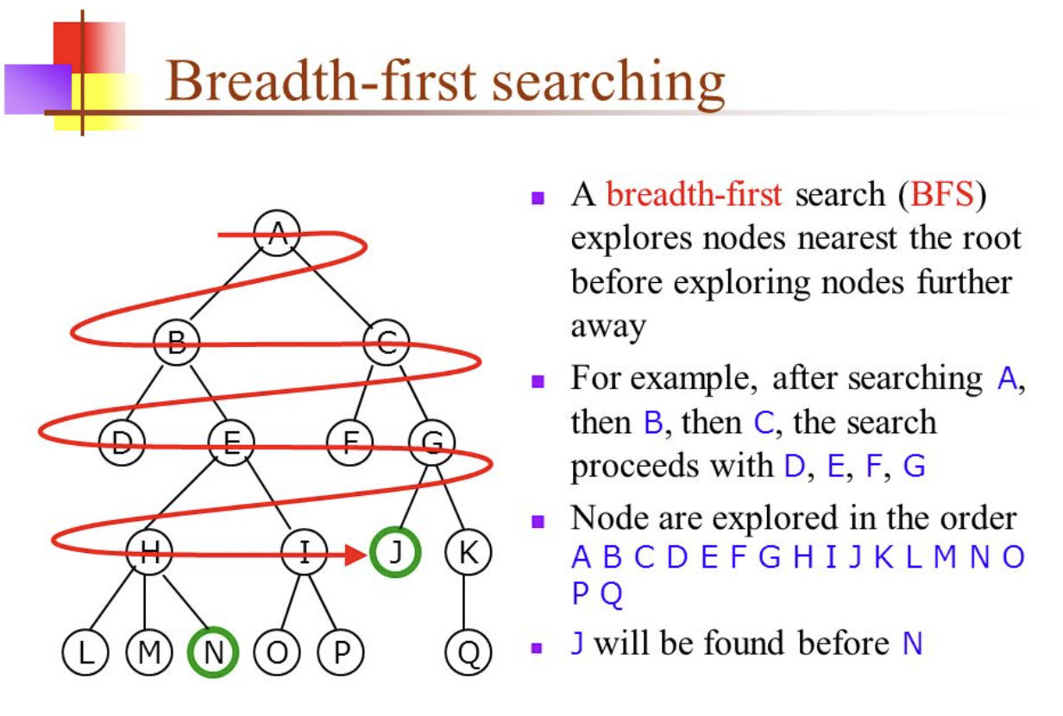
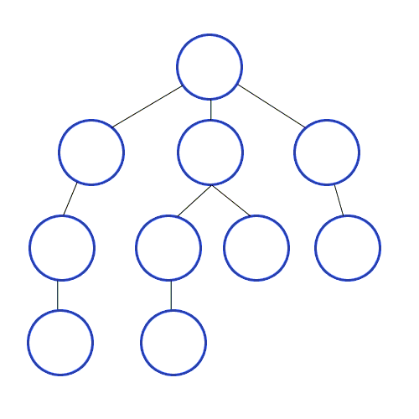
Algorithm

Slide 17

Diagrams

Slide 18
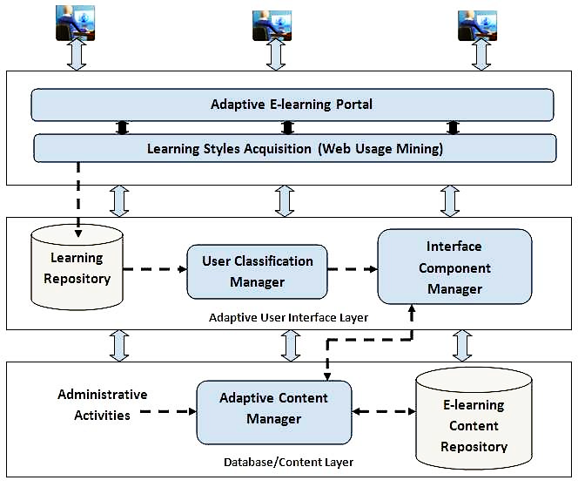
Conceptual Architecture Diagram

Slide 19
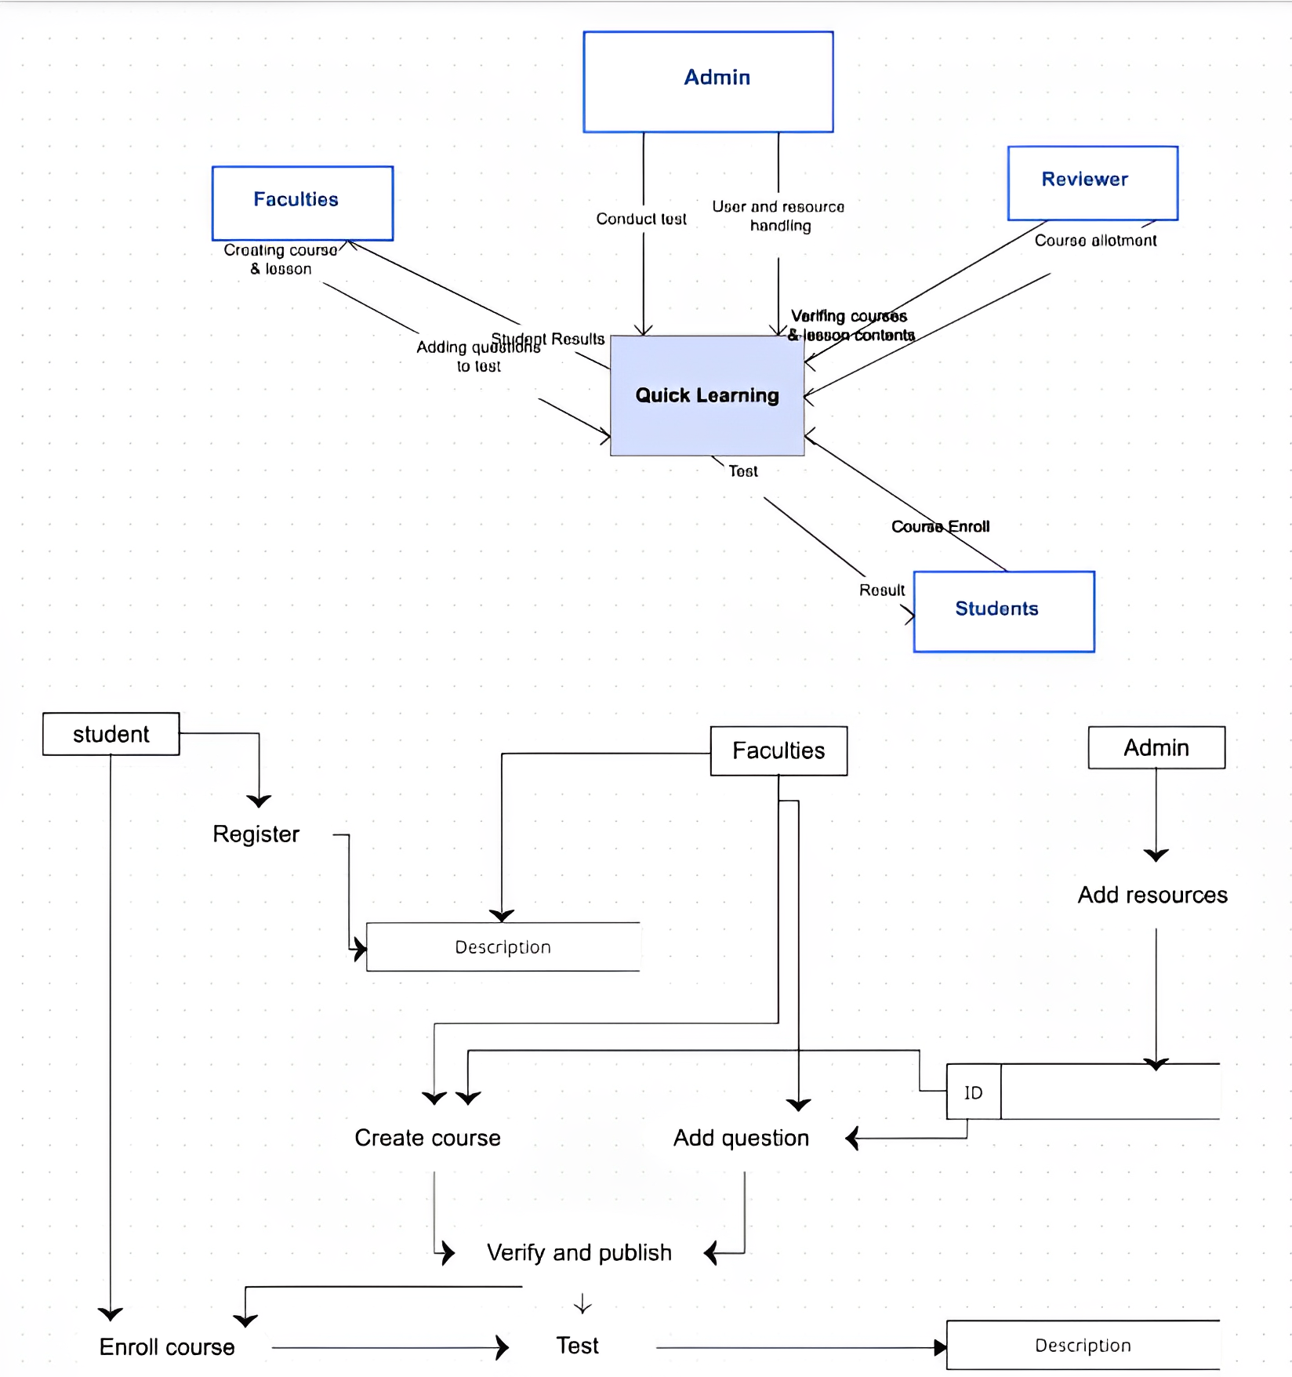
Context Diagram

Slide 20
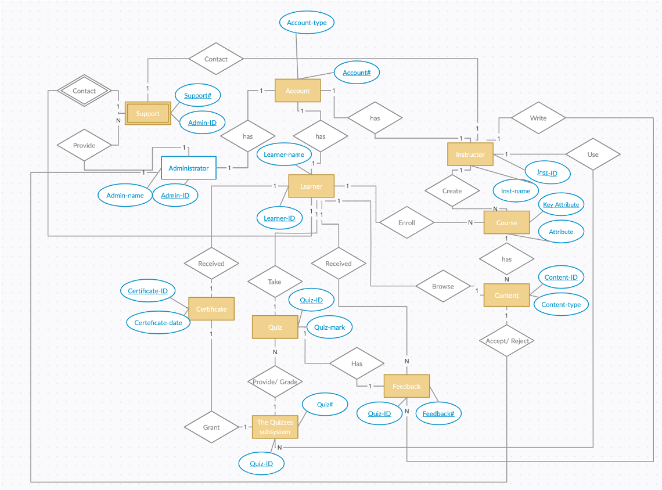
ER Diagram

Slide 21
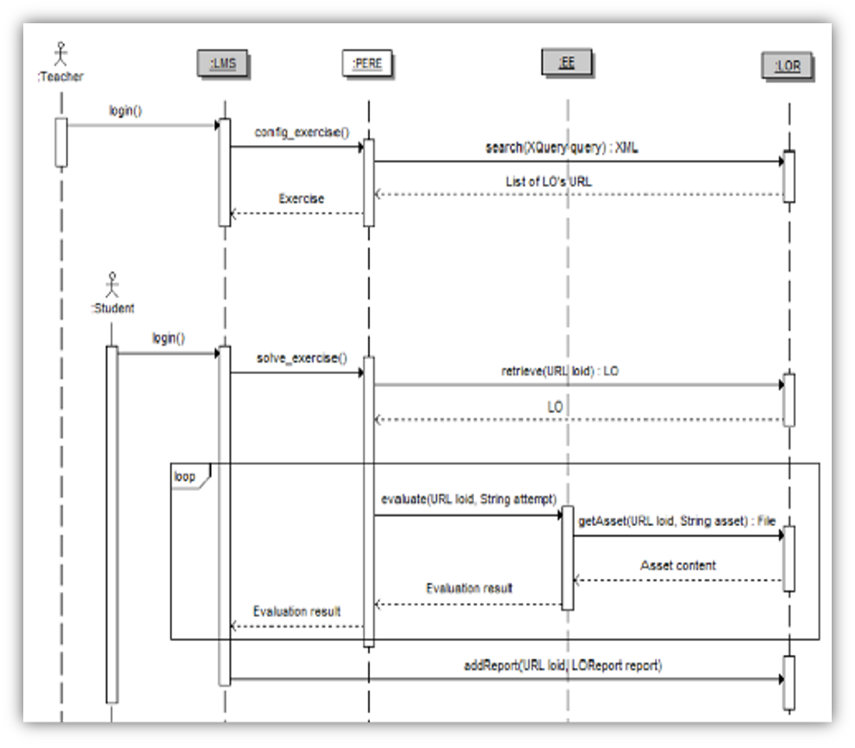
Sequence Diagram

Slide 22
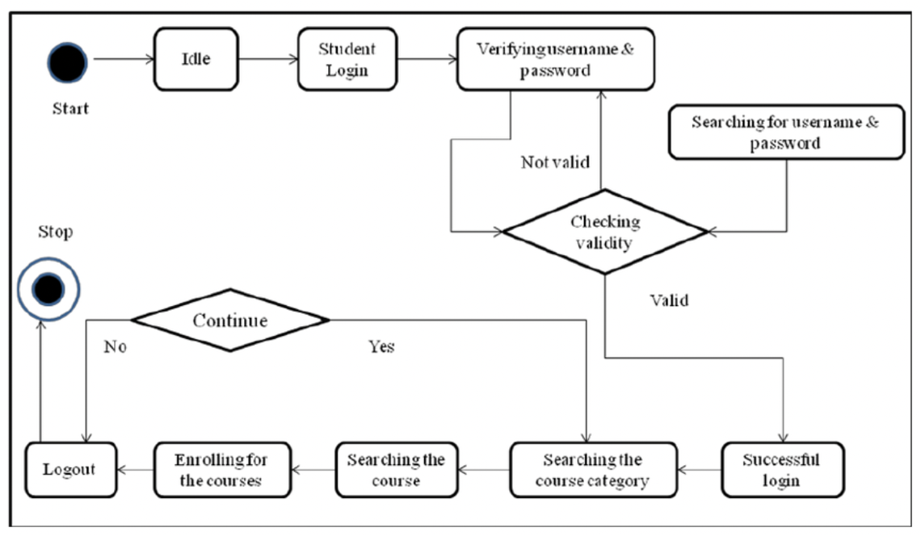
State Diagram

Slide 23
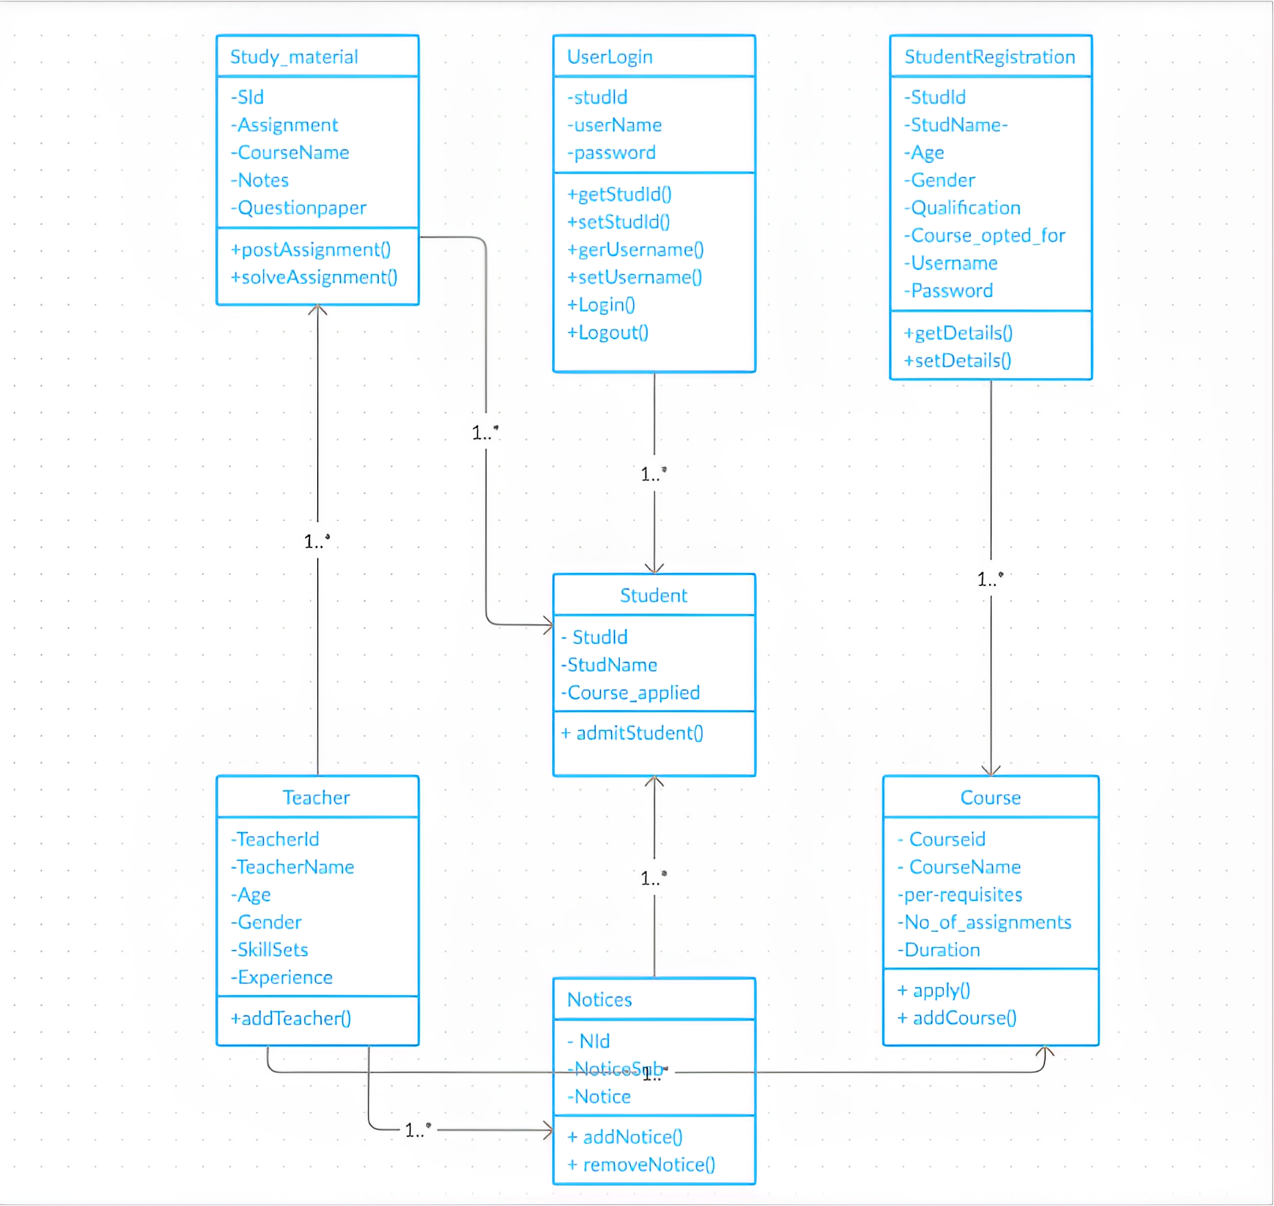
Class Diagram

Slide 24
Application Modeling
Departments, Courses, Professors, and Students list.
Maintaining and monitoring the professors and student's profile.
Communication channels.
Maintaining and monitoring courses content up-to-date.
Looking into Accounts.
Admin
Upcoming schedules.
List of courses.
Attend live classes.
Uploading course related contents.
Uploading assignments, quizzes and exams.
Give marks and feedbacks.
Monitoring the student's progress.
Conduct Study hours.
Special Classes.
Communication channels.
Quick Learning App
Authentication & Authorization
Professor
List of courses.
Weekly schedule.
Personal profile.
Upload assignments, write exams, submit quizzes.
Marks.
Achievements.
Workshops.
Badges.
Certifications.
Downloads.
Important (OR) Saved materials.
Handshake.
Communication channels.
Courses payment details.
Student

Slide 25
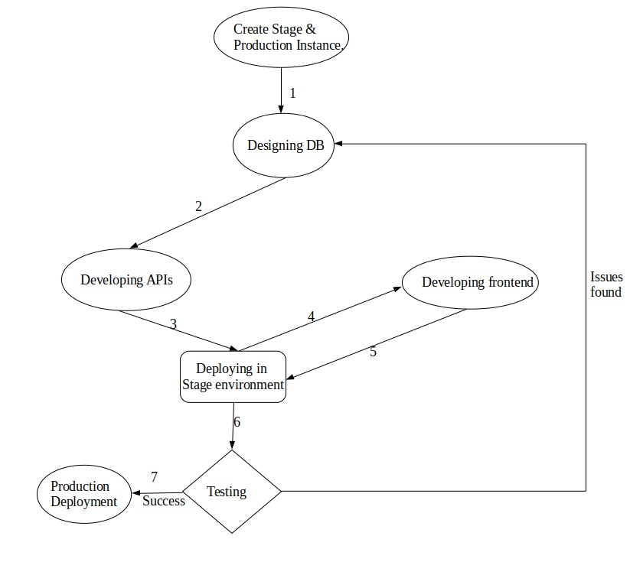







Software Development Cycle

Slide 26
Sprint 5 Recap
Project Recap
SignUp
Login
Logout
Create My Account
Update My Account
Forgot password
Add Course
List Course
Delete Course
Course Details
Course Wishlist​
Messages
Top 10 courses
Guest Profile
Content in my own language
Enrolment of student by Admin
Dashboard Report for Admin revenue and Instructor revenue
Revenue chart of every month in the Admin and Instructor dashboard
Categories for courses
Faster loading pages
Content in my own language
More features to Admin Dashboard

Slide 27
Product Backlog
Id | Issue Type | Story | Status | Story Points | Priority
BREW-107 | Task | Need to encrypt the password while storing in Database. | To-do | 3 | Low
BREW-108 | Story | As a Student, I want to do the payment so that I can join or able to see the class of the course that I want to learn. | To-do | 8 | Medium
BREW-139 | Story | As an Admin, I want to save my protocol, host, port, username and password, so that I can do the data transmission. | To-do | 3 | Medium
BREW-140 | Story | As an Admin, I want to give Instructor and admin revenue percentage, so that students can easily take the courses based on the percentage. | To-do | 3 | Medium
BREW-112 | Story | As a User, I want to see the notifications, so that I can be able to know the updates. | To-do | 5 | Medium
BREW-117 | Story | As a student, I want to check my grades, so that I will know my progress. | To-do | 5 | Low
BREW-129 | Story | As an Admin, I want to enroll the students, so that the students can attend the classes. | Done | 5 | High

Slide 28
Product Backlog
Id | Issue Type | Story | Status | Story Points | Priority
BREW-130 | Story | As an Admin, I want to see the admin revenue and instructor revenue, so that I can check the report. | Done | 5 | High
BREW-132 | Story | As a Student, I want to download the materials, so that I can see them offline as well. | To-do | 3 | Low
BREW-133 | Story | As a Professor, I want upload assignments, so that I can check the student's knowledge of my course. | To-do | 5 | Low
BREW-134 | Story | As a Student, I want to submit assignments, so that I professor can see my answers. | To-do | 5 | Low
BREW-137 | Story | As an Admin and Instructor, I want to see the revenue chart in the dashboard, so that I can check the revenue of every month. | Done | 8 | High
BREW-138 | Story | As a user, I want to know the categories of courses, so that it is easy for me to search for a course. | Done | 5 | High

Slide 29
Sprint Backlog
User Story ID | Summary | Story Point
BREW-129 | As an admin I want to be able to enroll student into the course So that they can access the course materials | 5
BREW-130 | As an admin I want to be able to see the revenue and course-wise revenue report So that I can communicate with them | 5
BREW-137 | As a professor I want to be able to see the course-wise revenue report So that the professor can review the revenue report | 8
BREW-138 | As an admin I want to be able to add new categories So that the admin can add a new category | 5

Slide 30
User Stories
User Story Id | Summary | Status
BREW-129 | As an admin I want to be able to enroll student into the course So that they can access the course materials | DONE
 | Scenario the admin wants to enroll the student Given the admin is logged in using the correct credentials When the admin adds the student to the course Then the student should be able to see the course material/details
BREW-130 | As an admin I want to be able to see the revenue and course-wise revenue report So that I can communicate with them | DONE
 | Scenario The admin wants to review the revenue report Given the admin is logged in using the correct credentials When the admin wants to review the revenue for a particular month/year Then he/she can review it easily
BREW-137 | As a professor I want to be able to see the course-wise revenue report So that the professor can review the revenue report | DONE
 | Scenario the professor wants to review the revenue report Given the professor is logged in using the correct credentials When the professor wants to review the revenue for a particular month/year Then he/she can review it easily.

Slide 31
User Stories
User Story Id | Summary | Status
BREW-138 | As an admin I want to be able to add new categories So that the admin can add a new category | DONE
 | Scenario the admin wants to add a new course Given the admin is logged in using the correct credentials When the admin wants to add a new course in a new category Then he/she can add the category followed by the course

Slide 32
Test Cases

Slide 33
Stories Completed and Stories Not Completed
User Story ID | Summary | Story Point | Status
BREW-129 | As an Admin, I want to enroll the students, so that the students can attend the classes | 5 | Completed
BREW-130 | As an Admin, I want to see the admin revenue and instructor revenue, so that I can check the report. | 5 | Completed
BREW-137 | As an Admin and Instructor, I want to see the revenue chart in the dashboard, so that I can check the revenue of every month. | 8 | Completed
BREW-138 | As a user, I want to know the categories of courses, so that it is easy for me to search for a course. | 5 | Completed

Slide 34

Metrics

Slide 35

Team Velocity Chart

Slide 36
Team Historical Velocity (Average)

Slide 37
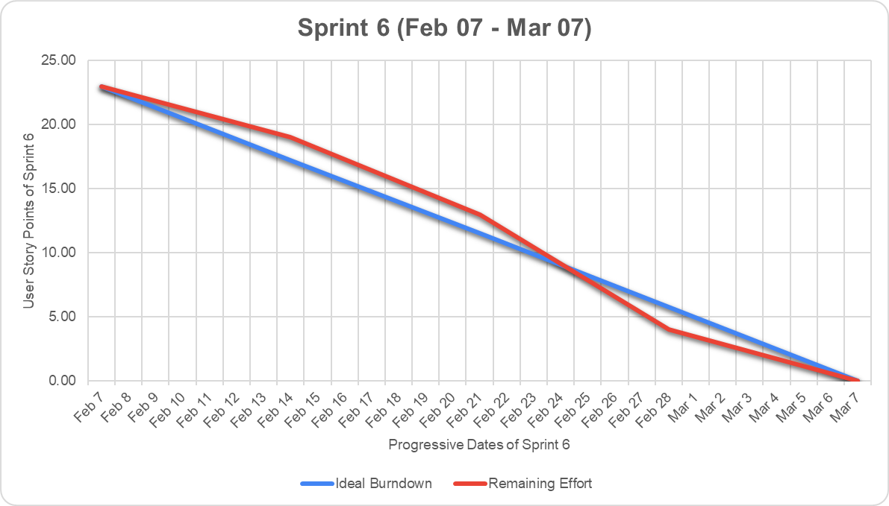
Burndown Chart

Slide 38
Committed Against Completed Ratio

Slide 39

Retrospective

Slide 40
What went well?
Team members have open and sincere conversations thinking together how to improve as a team.
Transparency, united team and shared expectations.
We were able to define the goal of the Sprint.
Deep involvement and awareness of the team that gives unexpected valuable insights.
Going experimental on our process by trying new things on a frequent basis and holding regular retrospectives to validate our experiments.
Working smarter and seeing solutions evolve through collaboration.

Slide 41
What did not go well?
We lagged at Proactive problem-solving and quick resolution of technical challenges are critical for maintaining sprint timelines.
Our testing process was not as efficient as we hoped, which resulted in some last-minute bug fixes.
We could not estimate the subtasks that occurred during the sprint.

Slide 42
What needs improvement?
Establish a process for proactive problem-solving to minimize delays
We can improve our testing process by involving QA earlier in the development process.
We should estimate all the sub task at the starting of the sprint.

Slide 43
Stories Planned and Committed for Sprint 5
Story_ID | Stories | Status
BREW-139 | As an Admin, I want to save my protocol, host, port, username and password, so that I can do the data transmission. | To-do
BREW-108 | As a Student, I want to do the payment so that I can join or able to see the class of the course that I want to learn. | To-do
BREW-112 | As a User, I want to see the notifications, so that I can be able to know the updates. | To-do
BREW-129 | As a Professor, I want to upload the materials for the course, so that students can revise everything that I taught. | To-do

Slide 44

Slides App Screenshot

Slide 45
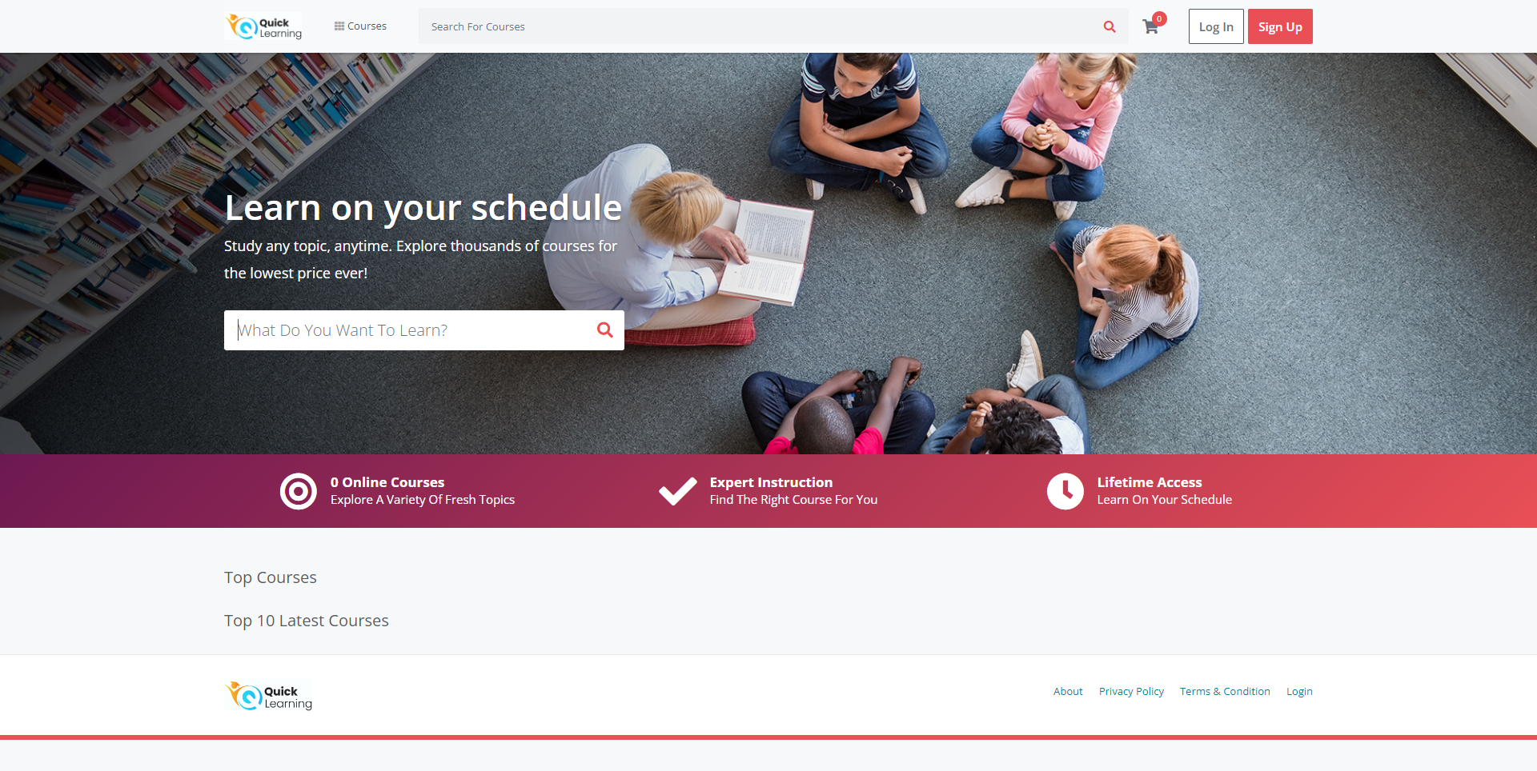
Home Page with Search Bar to search for courses

Slide 46
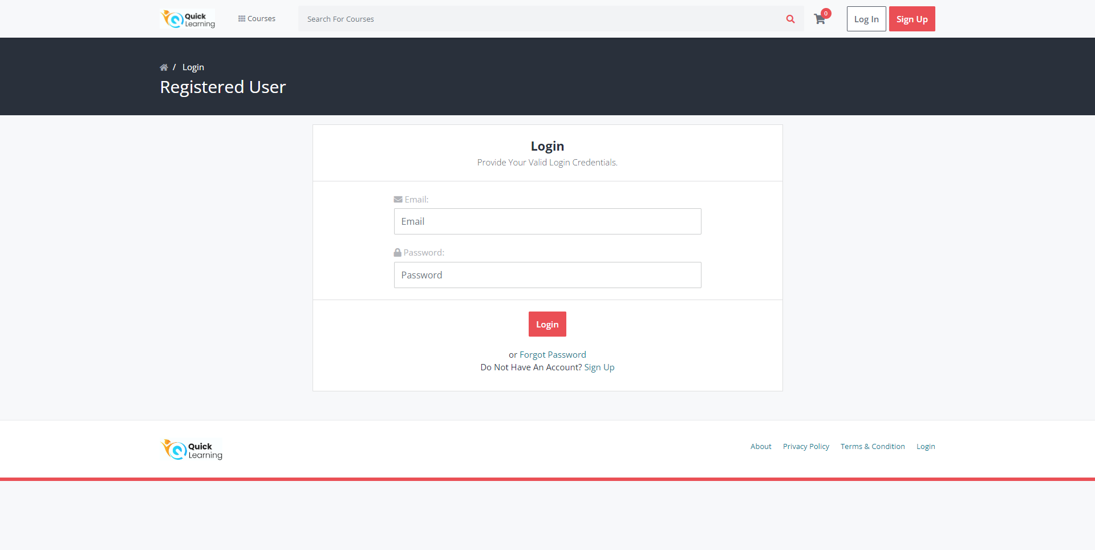
Login Page

Slide 47
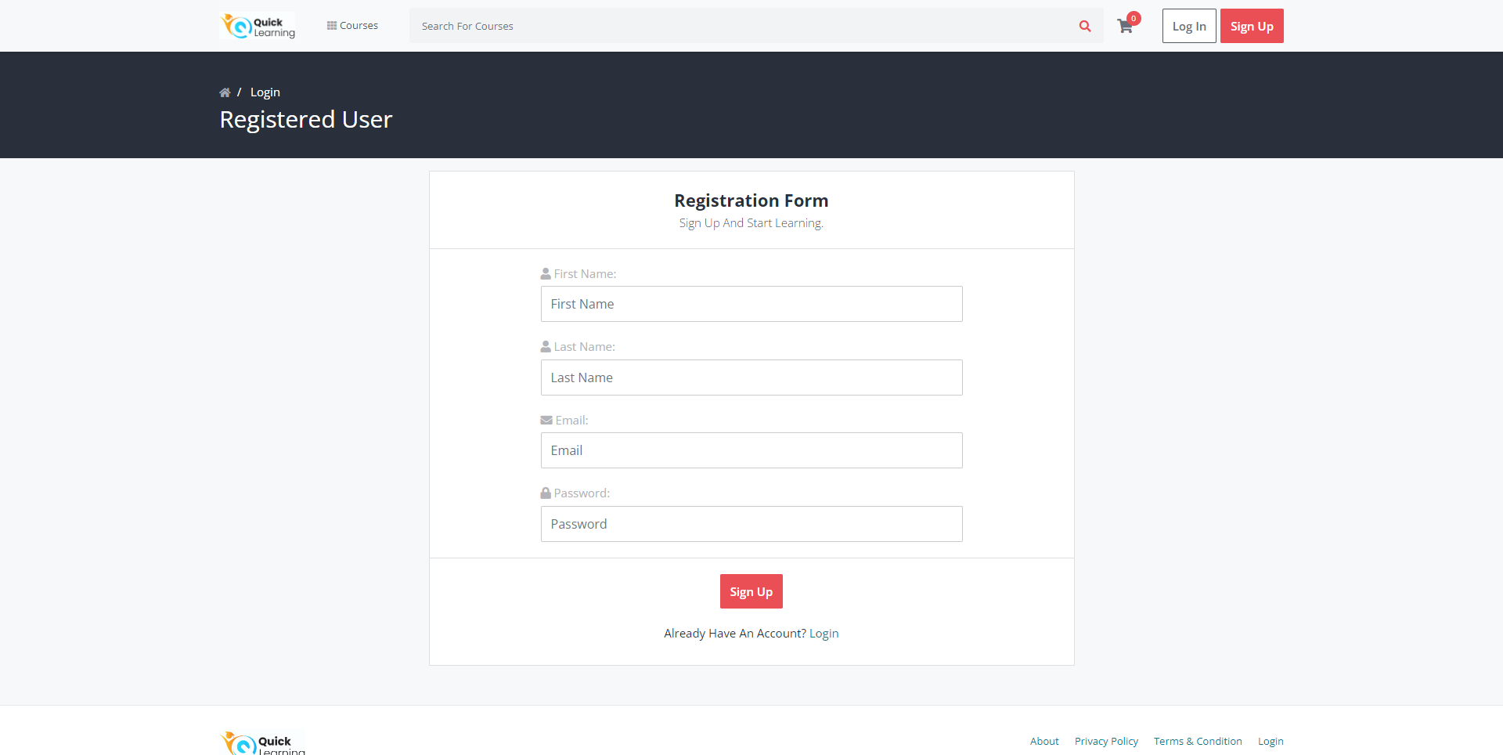
SignUp Page

Slide 48
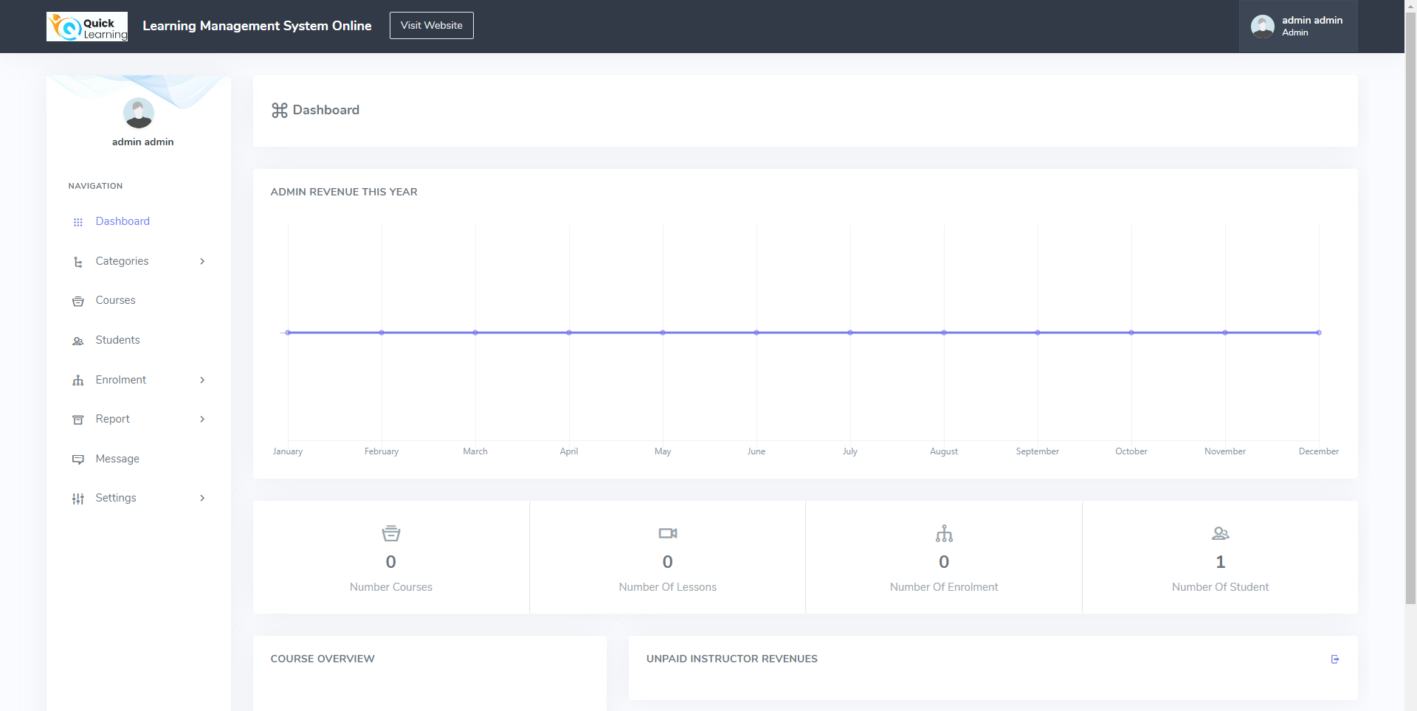
Admin Dashboard

Slide 49
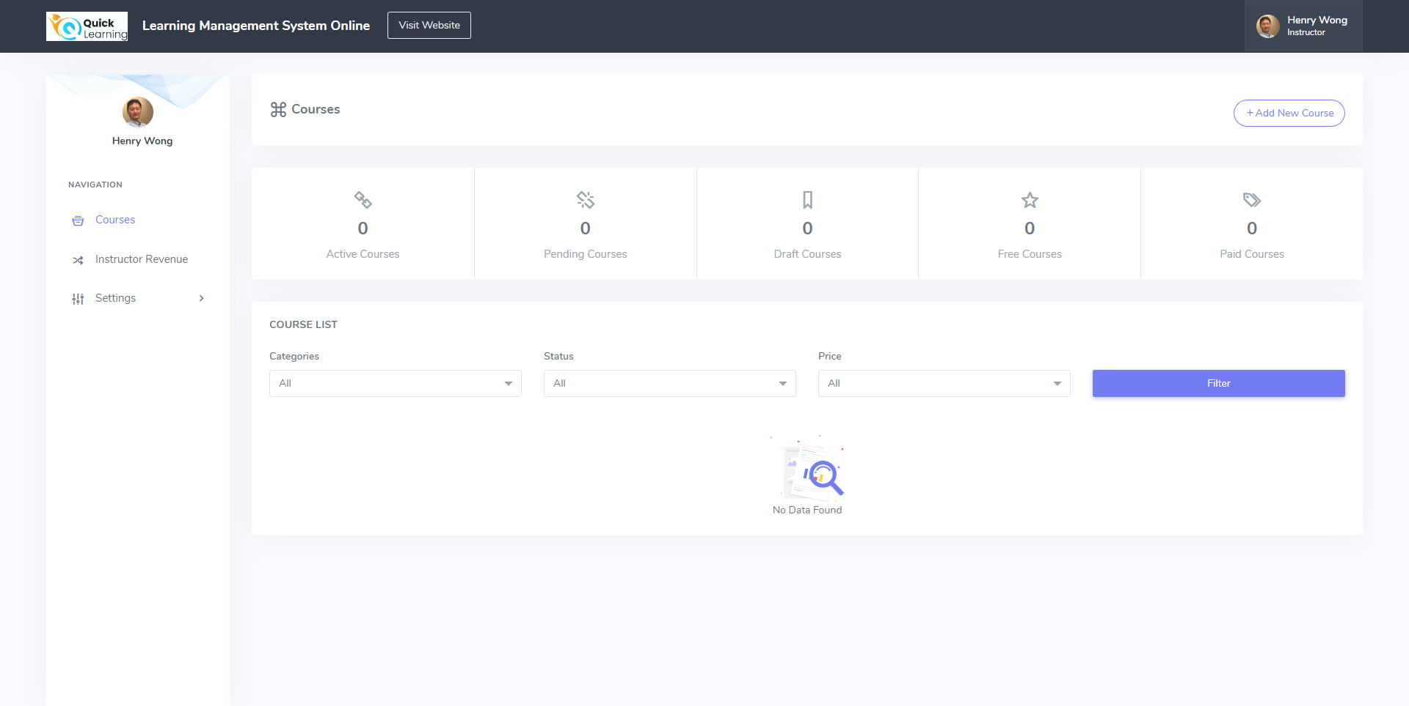
Instructor/Professor Dashboard

Slide 50
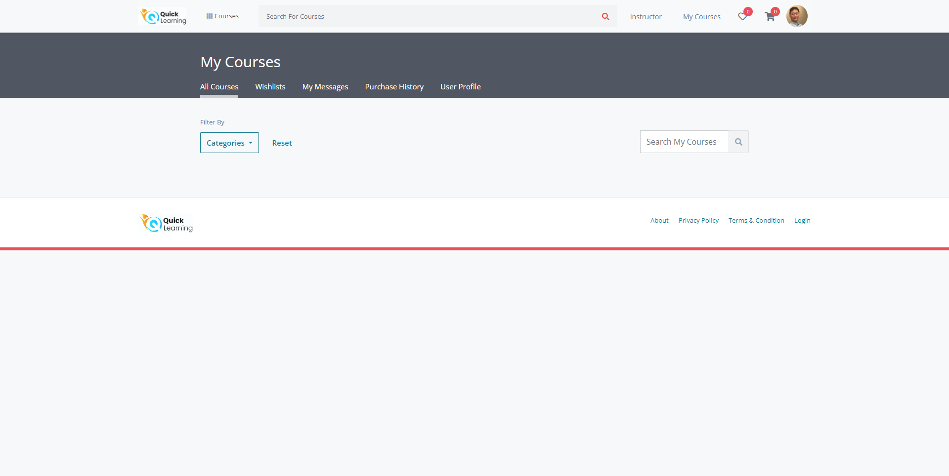
My Courses Page

Slide 51
Visit our WikiLink
https://github.com/htmw/QuickLearning/wiki
https://github.com/BrewingTechnologies/QuickLearning/wiki

Slide 52

Live Application Demo

Slide 53
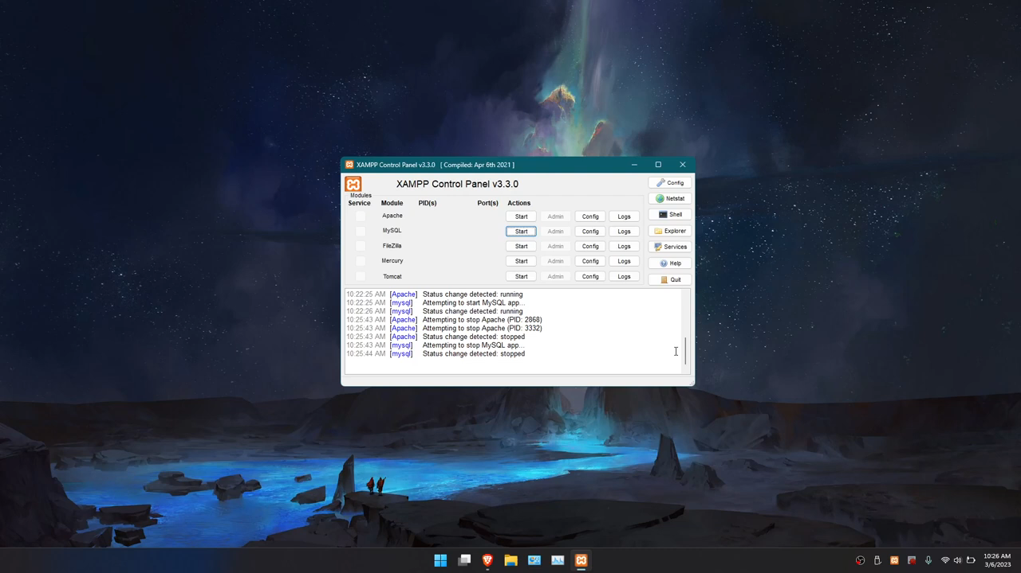

Slide 54

Happy Learning! Thank You for your patience and attention!

